Slide 1

Online Videogame Store
Márquez Rodríguez, Alba - 268941

Slide 2
Index
Introduction
Proccess
Technologies used
Difficulties
Result
Application

Slide 3




Introduction
Videogames Store
Information on Videogames Store Platforms

Slide 4
Process
Conceptual and Logical Diagram
Physical Diagram
Database Creation
CRUD Operations
Database Population
Application Creation
Views Diagram

Slide 5
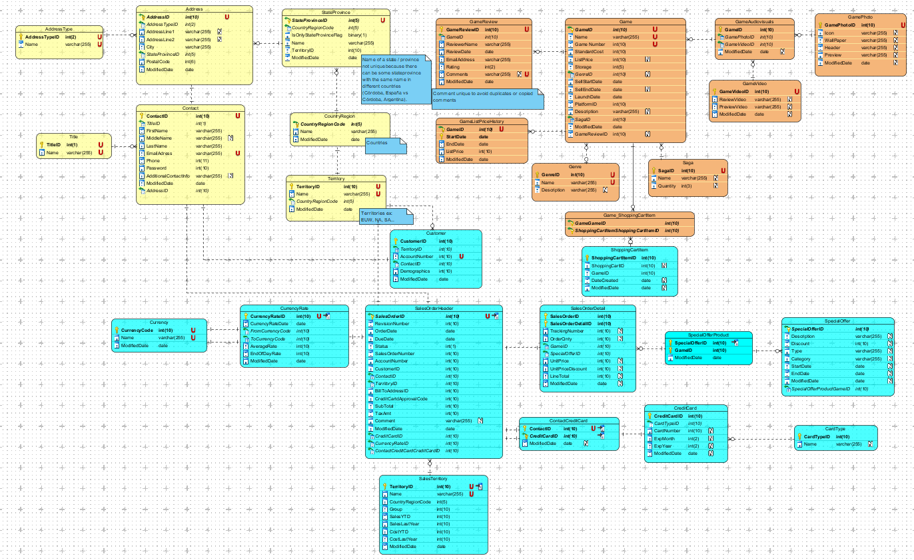
Logical DIagram
Contacts
28 tables
Sales
Games
Done in VisualParadigm

Slide 6
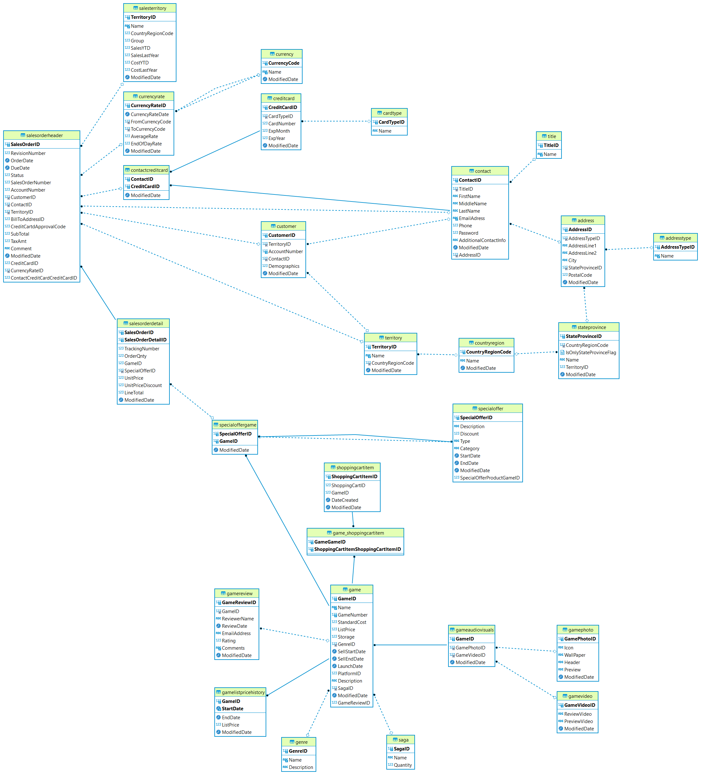
Physical Diagram
Done in DBeaver

Slide 7
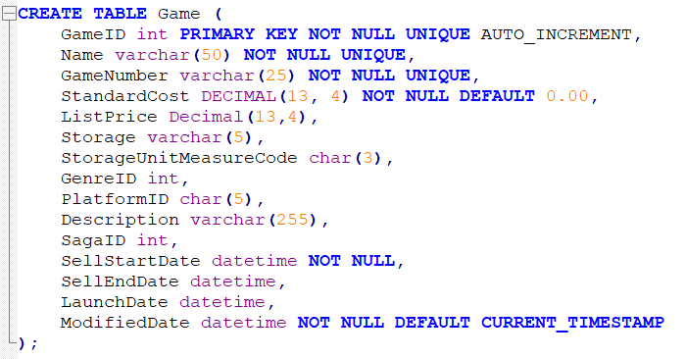
Database Creation
SQL Statements
Create

Slide 8
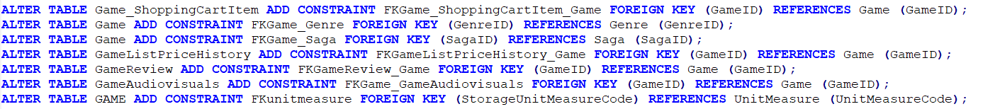
Database Creation
SQL Statements
Create
Alter

Slide 9
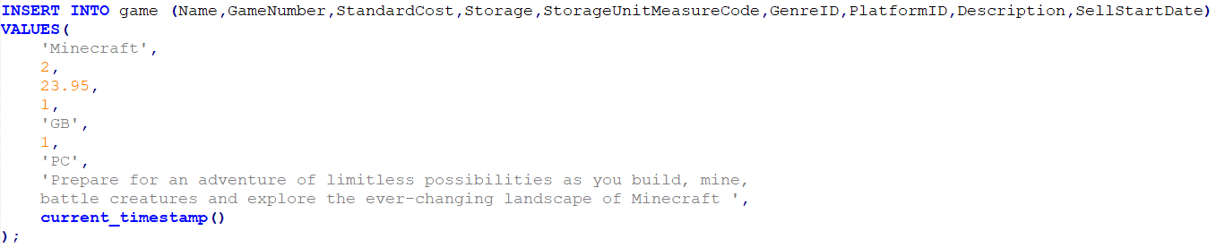
Database Population
SQL Statements
INSERT INTO

Slide 10
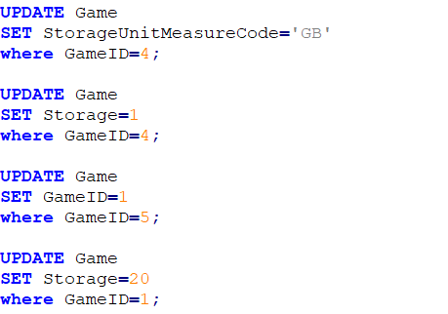
CRUD Operations
SQL Statements

Slide 11
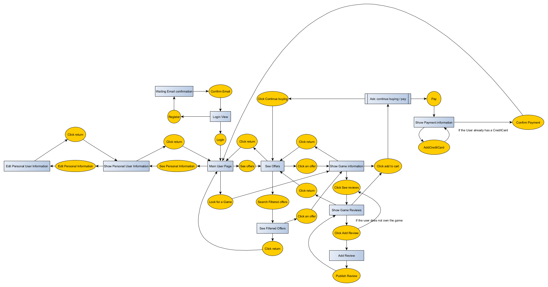
CRUD Operations
12 Views
+ messages
+ console view
Done in yED

Slide 12
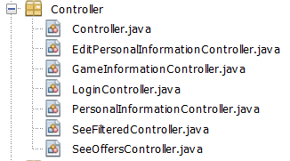
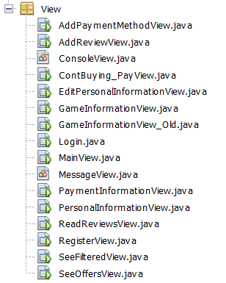
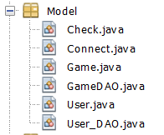

Application Creation
7 Controllers
Controller
Connect
Game
User
15 Views
View
Model

Slide 13
Application Creation
7 Controllers
Controller
Connect
Game
User
15 Views
View
Model

Slide 14
VisualParadigm
DBeaver
MySQL
Apache Netbeans IDE 12.5
yED
Technologies Used

Slide 15

Results

Slide 16

Thank You

